Slide 1
Capstone Project
Sales Prediction of Rossmann Stores
By Akash A Desai

Slide 2
Sales Prediction of Rossmann Stores 1.Business Understanding 2.Data Understanding 3.Data cleaning 4.Data analysis (EDA) 5.Data preparation 6.Feature Engineering 7.Model Building 8.Evaluation of model 9.Challenges 10.Conclusion

Slide 3
Business Understanding
Rossmann operates over 3,000 drug stores in 7 European countries. Currently, Rossmann store managers are tasked with predicting their daily sales for up to six weeks in advance. Store sales are influenced by many factors, including promotions, competition, school and state holidays, seasonality, and locality. With thousands of individual managers predicting sales based on their unique circumstances, the accuracy of results can be quite varied.
You are provided with historical sales data for 1,115 Rossmann stores. The task is to forecast the "Sales" column for the test set. Note that some stores in the dataset were temporarily closed for refurbishment

Slide 4

Evaluation Criteria:
Submissions are evaluated on the Root Mean Square Percentage Error(RMSPE). Lower the score
better will be the prediction.
where yi denotes the sales of a single store on a single day and yi_hat denotes the corresponding prediction. Anyday and store with 0 sales is ignored in scoring.

Slide 5
Impact of Solution
● Better management of staff schedules.
● Provide enough time to store managers to focus on customers and their teams.
● Increase efficiency of employees.

Slide 6
Data Understanding
Client provided dataset in two files
1.Rossmann Stores Data.csv - historical data including Sales
2.store.csv - supplemental information about the stores

Slide 7
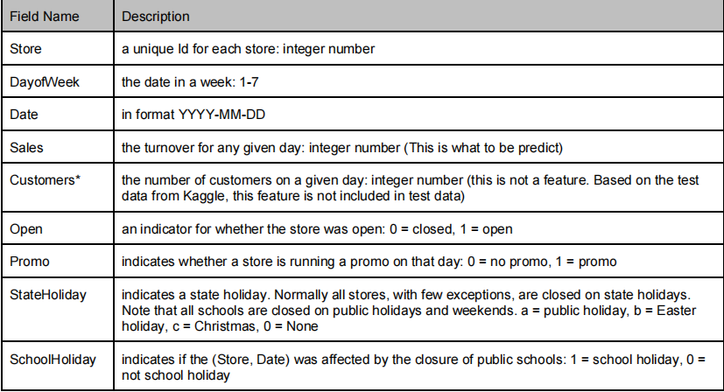
.Dataset and Features Training data is comprised of two parts. One part is historical daily sales data of each store from 01/01/2013 to 07/31/2015. This part of data has about 1 million entries. Data included multiple features that could impact sales. Table 1 describes all the fields in this training data.

Slide 8
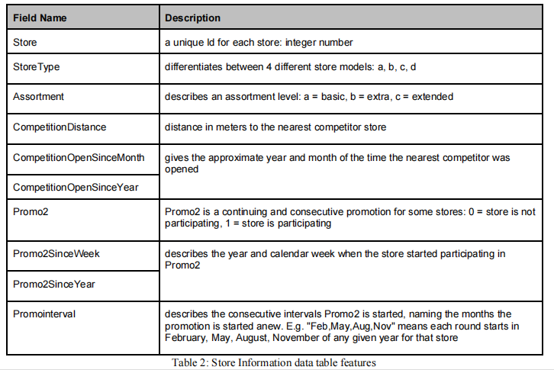
The second part of training data is supplement store information. It has 1115 store info entries, which listed the store type, competitor and a different kind promotion info. Table 2 below describes all the field in this file.

Slide 9
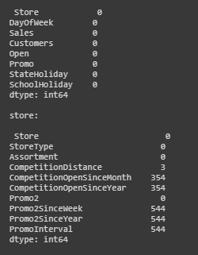
Data preprocessing-missing values

Slide 10
Data Preprocessing
-I started data preparation with reading of stores and train datasets into separate data frames with
including feature for parsing of dates.
- Handling of missing values: I first performed analysis on both to check number of missing values
in each data. Features in train data did not have any missing values. Features in stores such as
CompetitionOpenSince and Promo2Since contained half of missing values. As these are dates so
cannot be replaced by mean or 0, so I removed those features from the data.
- Feature CompetitionDistance having very small number of missing values. So I first analyzed
distribution of its values and found that lot of values are around its median. So I replaced missing
values with median.
- Then I removed number of entries for stores those were closed as sales for them was zero and will
not helpful in prediction task. On similar lines I removed rows for which sales was 0. This is
because it will make our models biased towards outliers.
- Extracted 3 new columns for month, year and day from date column and dropped date column.
To train our models we need features from both of stores and train data. So I joined both of the
table using left join.

Slide 11
Addition of features:
Addition of features:
- Added “AvgSales” feature which is calculated by taking monthly averages from each store. These
proved important when I visualized relation between average sales and actual sales for each store.
- Also added “AveCustomer” number which gives monthly average of customers visited to the
store. This can be used to identify popularity of store.
- Performed label encoding for categorical attributes such as StateHoliday, Assortment and
StoreType. This also important to prepare data before giving input to our regression models.

Slide 12
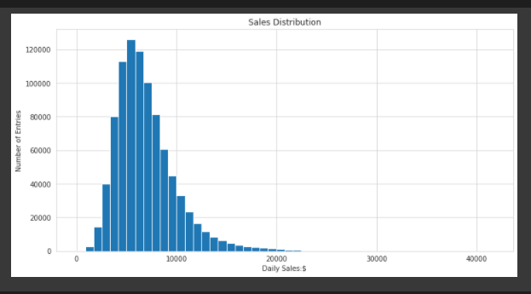
EDA
From histogram it can be observed that high number of stores having daily sales of around 5/6
thousands.
- Then I obtained similar kind of histogram for customer distribution.

Slide 13
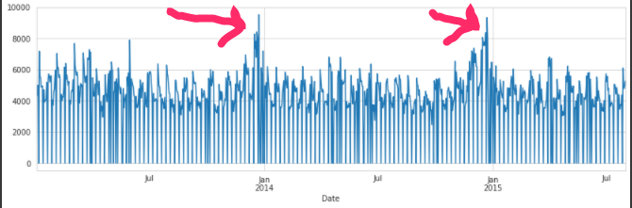
sales vs date
starting of new year has highest sales

Slide 14
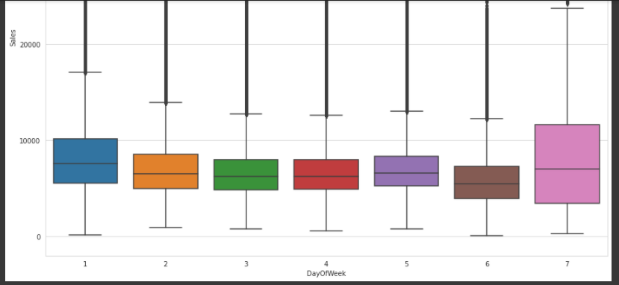
Dayoweekek vs sales
From the plot, we can tell that Tue through Fri’s sales distributions are very close. Mon, Sat and Sun’s sales distributions are unique. In database, DayofWeek is represented as numeric number 1­7. From intuitive, we know that there is no linear relationship from 1­7 number to sales data. We treat DayofWeek as four factors, Mon, Weekday(Tue­Fri), Sat, Sun.

Slide 15
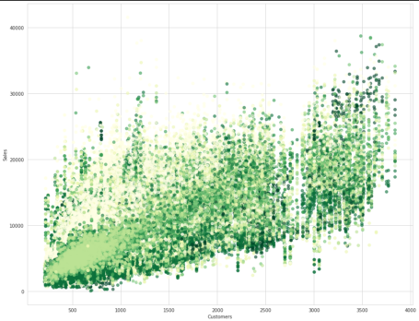
Customer Vs Sales of Different Days of the Week - As no of customer increses ,sales also incresing
.

Slide 16
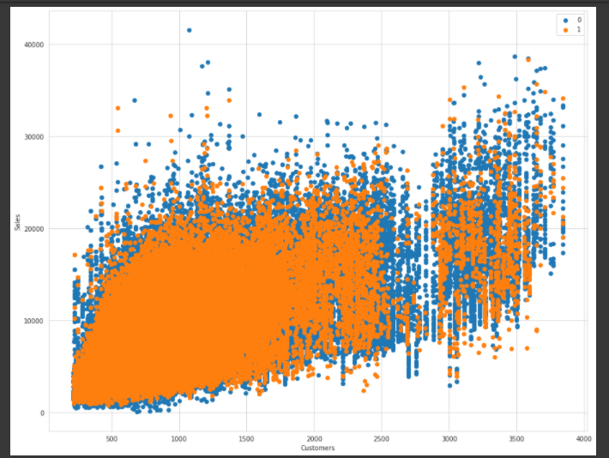
School Holiday Vs Sales School Holidays doesnt have much impact on sales at the store

Slide 17
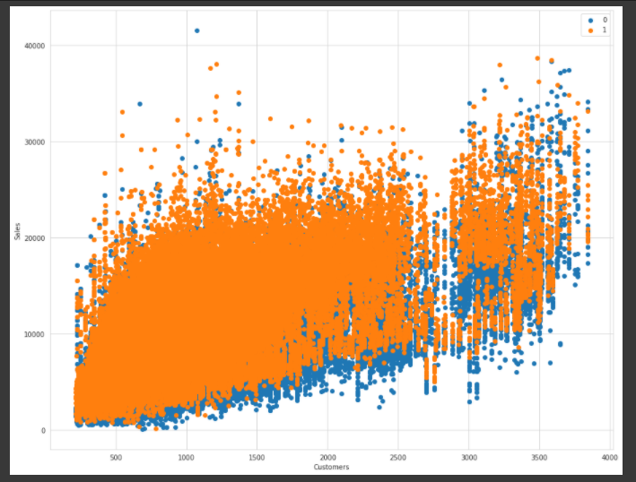
Effect of Promo Code on Sales - We know by intution that promo code should have an effect on sales.We can confirm from the above plot that promo code did have an affect on the sales.

Slide 18
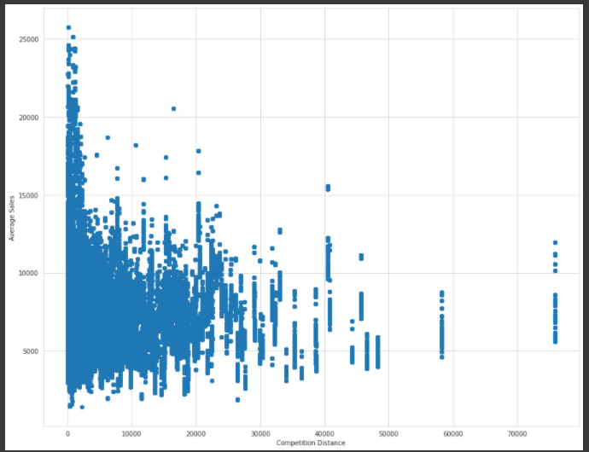
Competition Distance Vs Average Sales

Slide 19
Competition Distance is the distance of other store with the Rossmann Store.We can see that when the competition disance is low then the sales is more.This is counter intutive that if there are competitors aroud you then your sales is also more.
This is because store are more in urban areas. And in urban areas the stores of competitors are also present.Sales happen more in Urban areas that is why even if competitors are nearby the sales are more.

Slide 20
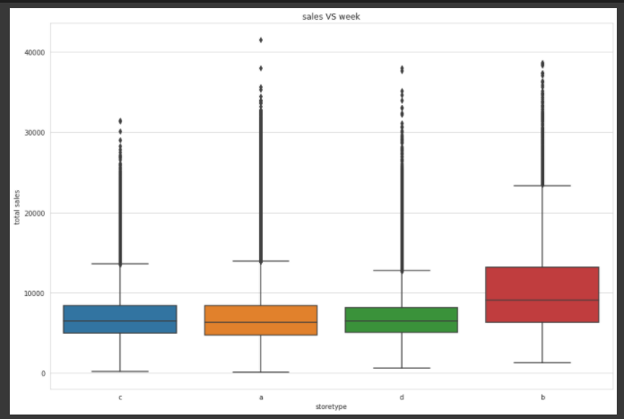
Sales by Store Type
store b has high sales ,& a,c &d having almost same sale

Slide 21
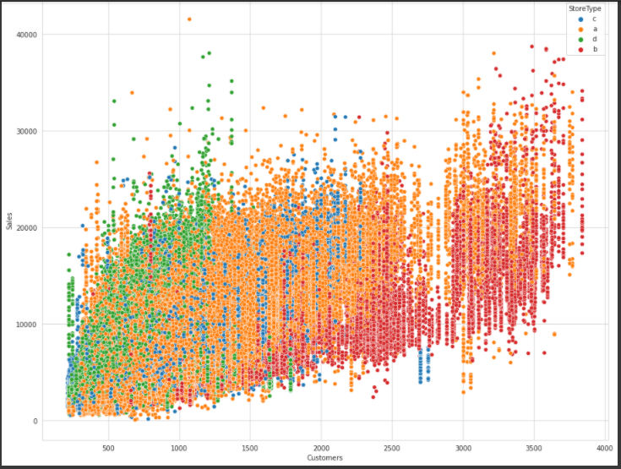

Slide 22
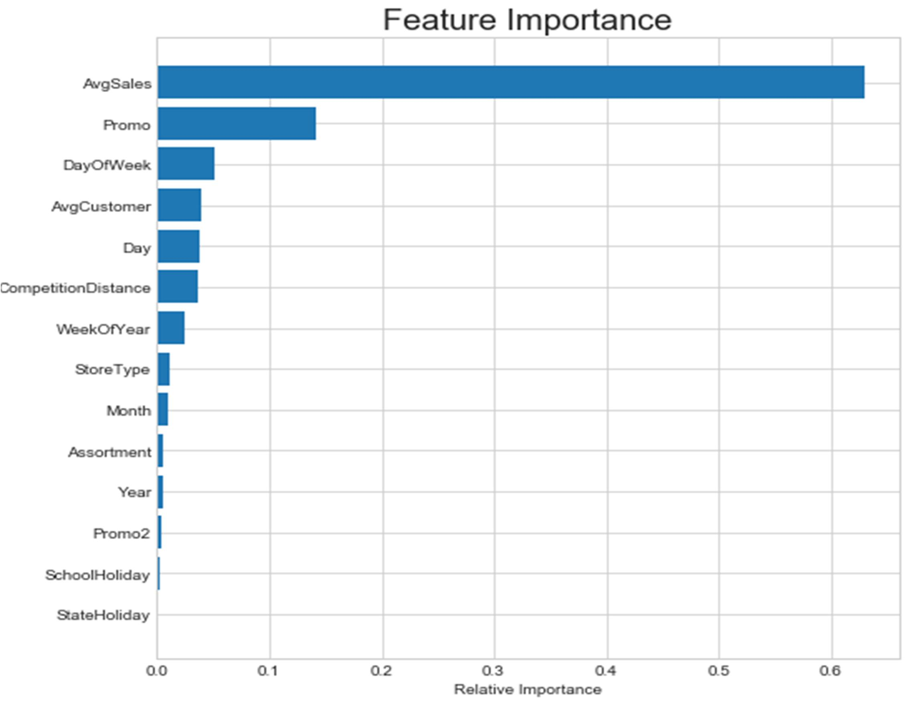
Feature selection

Slide 23
We can observe from this plot that our newly added feature “AvgSales” proved to very important in terms
of predicting daily sales. From this we can observe fact that if we know history of average sales for
particular store then we can predict that store’s sales accurately. The same thing can be observed from
correlation matrix between these features. AvgSales, AvgCustomer and Promo are highly correlated to Sales.

Slide 24
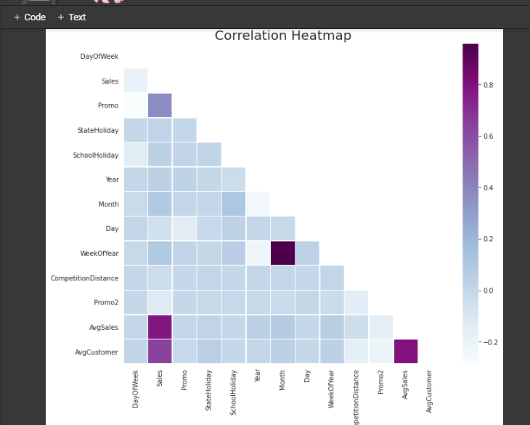

Slide 25
.
We can observe from this plot that our newly added feature “AvgSales” proved to very important in terms
of predicting daily sales. From this we can observe fact that if we know history of average sales for
particular store then we can predict that store’s sales accurately. The same thing can be observed from
correlation matrix between these features. AvgSales, AvgCustomer and Promo are highly correlated to
Sales.

Slide 26
Model selection
Regression Models:
- I first started with splitting of data into train and test subsets. Then I defined functions for
evaluation using Root Mean Square Percentage Error (RMSPE) and Mean Absolute Percentage
Error (MAPE).
- I used three different regression models for the sales prediction task. Basic idea behind using 5 different regression models is to compare performance of different techniques on this task and then selection of best model to extract results.

Slide 27
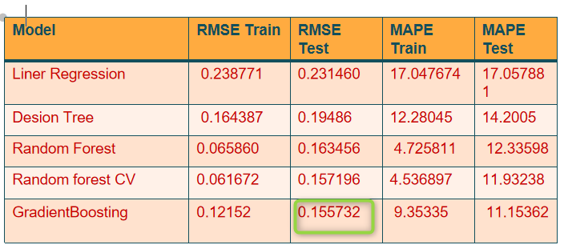
Result

Slide 28
By using proper features from dataset and model hyperparameters I achieved RMSPE score around
0.115 which can be in top 10% result got using random forest on this challenge. From table 1, we can
also look out for performance of decision tree regression which is far better than baseline linear regression
model.

Slide 29
conclusion
From results we not observed much of seasonality even small increase of sales in December. But which
can also be valid considering fact that these are drug stores. So will not be much affected by festival
season. But it is observed that AvgSales for Rossmann stores are increasing year by year from 2013-2015.
So as a company it is doing well so AvgSales show growth of 3-5% each year. This is important in
predicting future sales.
While performing experiment addition and removal of features such as StoreType, Assortment, Month
and Year in training data to models not shown much impact on results. Changes in RMSPE score very
less in each scenario and even not consistent. So we can say that that these features are not impacting
sales that much.
In conclusion this is very interesting Data Science problem to solve where feature selection is important
part of prediction accurately. I was able to successfully forecast daily sales for these stores using Linear
Regression, Decision Tree Regression and Random Forest Regression models. I also analyzed trends and
useful insights from results which can be prove to be important for Rossmann. In future I can work on
other regression methods such as gradient boosting to improve results further. Also there is scope to add
external real world features about these stores to predict future sales more accurately.

